Slide 1
Statistical learning:
Given a vector of inputs X, and an output quantity y, a function exists such that
Random error (mean 0, effects on y not capture by X)
Unknown function

Slide 2

Features: X
$
Labels: y
$$$
Some ML Model
...
Example
Parameters:
Are the model
Do the math
Hyperparameters:
Format of model
Dictate the final parameters

Slide 3



Architecture
Hyperparameters: choices we make
Feature Engineering
Parameters: learned through training

Slide 4
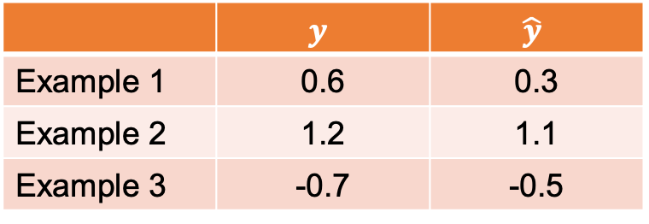
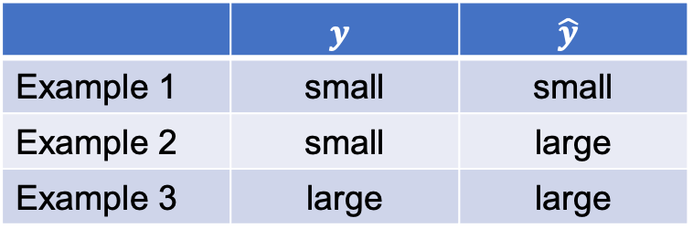
Nominal Labels:
Classification
Quantitative Labels:
Regression
 | $$y$$ | $$\hat{y}$$
Example 1 | small | small
Example 2 | small | large
Example 3 | large | large
 | $$y$$ | $$\hat{y}$$
Example 1 | 0.6 | 0.3
Example 2 | 1.2 | 1.1
Example 3 | -0.7 | -0.5
Accuracy on this data: 66%
Mean Absolute Error on this data: 0.2

Slide 5
Features:
QAF used
HBD used
Molar ratio
$
Labels: is the sample solid?
$$$
Some ML Model

Slide 6
Test set:
Use to evaluate and communicate performance
Development (dev) set:
Use for training and optimizing model

Slide 7
Training distro
Test distro
Model is unfamiliar with mixtures with high mol fraction. Not a fair test.
0.0
1.0
Mol fraction QAS

Slide 8
?
A
B
?
?

Slide 10
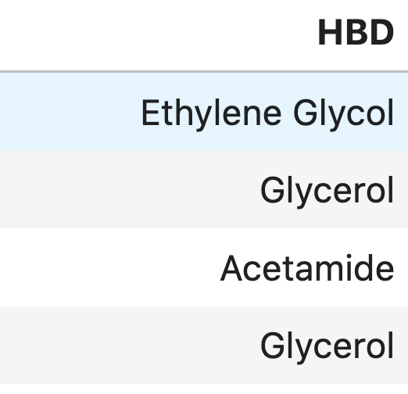
Is Ethylene Glycol | Is Glycerol | Is Acetamide
1 | 0 | 0
0 | 1 | 0
0 | 0 | 1
0 | 1 | 0
For each example: One “1” and the rest are “0”

Slide 11
Original
A
B
Minmax Scaled
Standardized
1.0
0.0
1.0
0.0

Slide 12
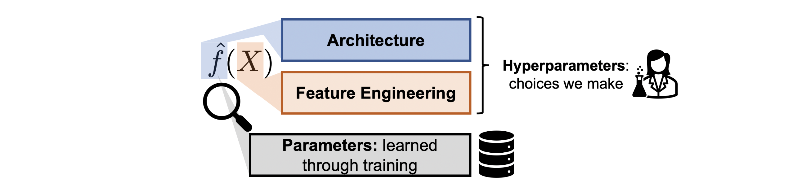
KNN
Features:
QAS ratio
HBD (OneHot encoded)
QAS (OneHot encoded)

Slide 13
Feature Engineering
Feature Extraction
Feature Selection
Compute or estimate features
Encode nominal values
Cross reference for feature
Remove redundant features
Remove inconvenient feats
Increase interpretability

Slide 14
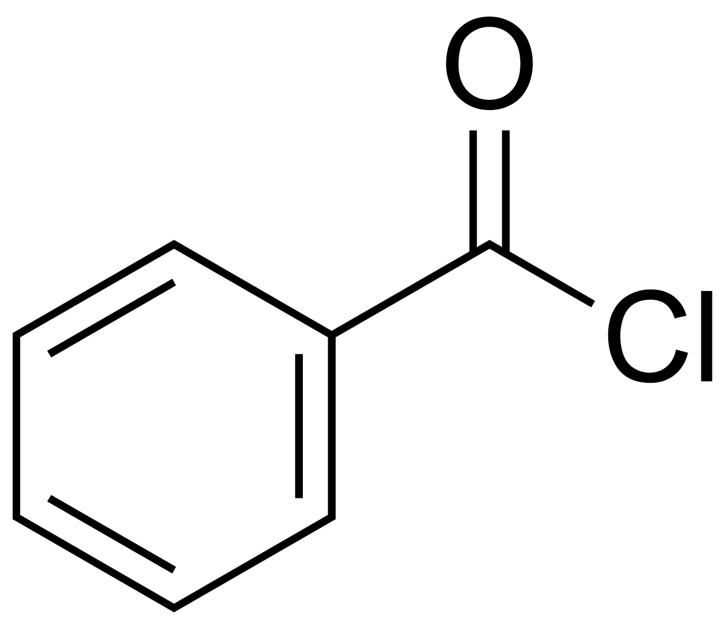

Slide 15
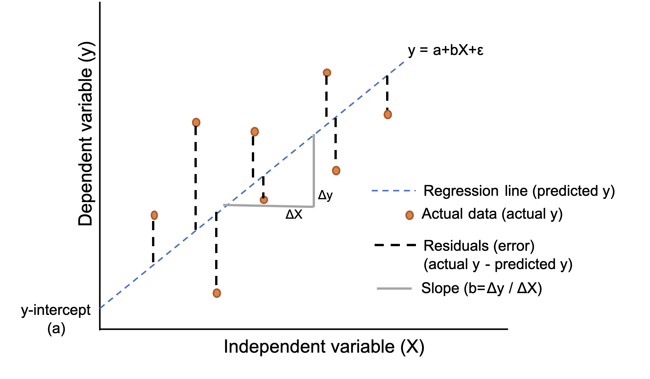
v

Slide 16
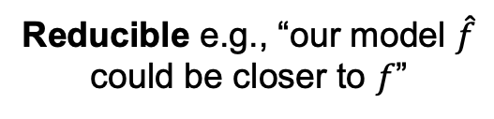
Reducible e.g., “our model $\hat{f}$ could be closer to $f$”
Irreducible

Slide 17
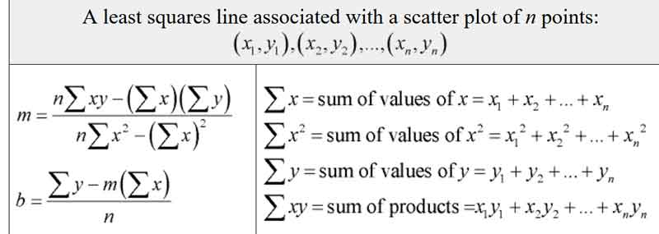

Slide 18
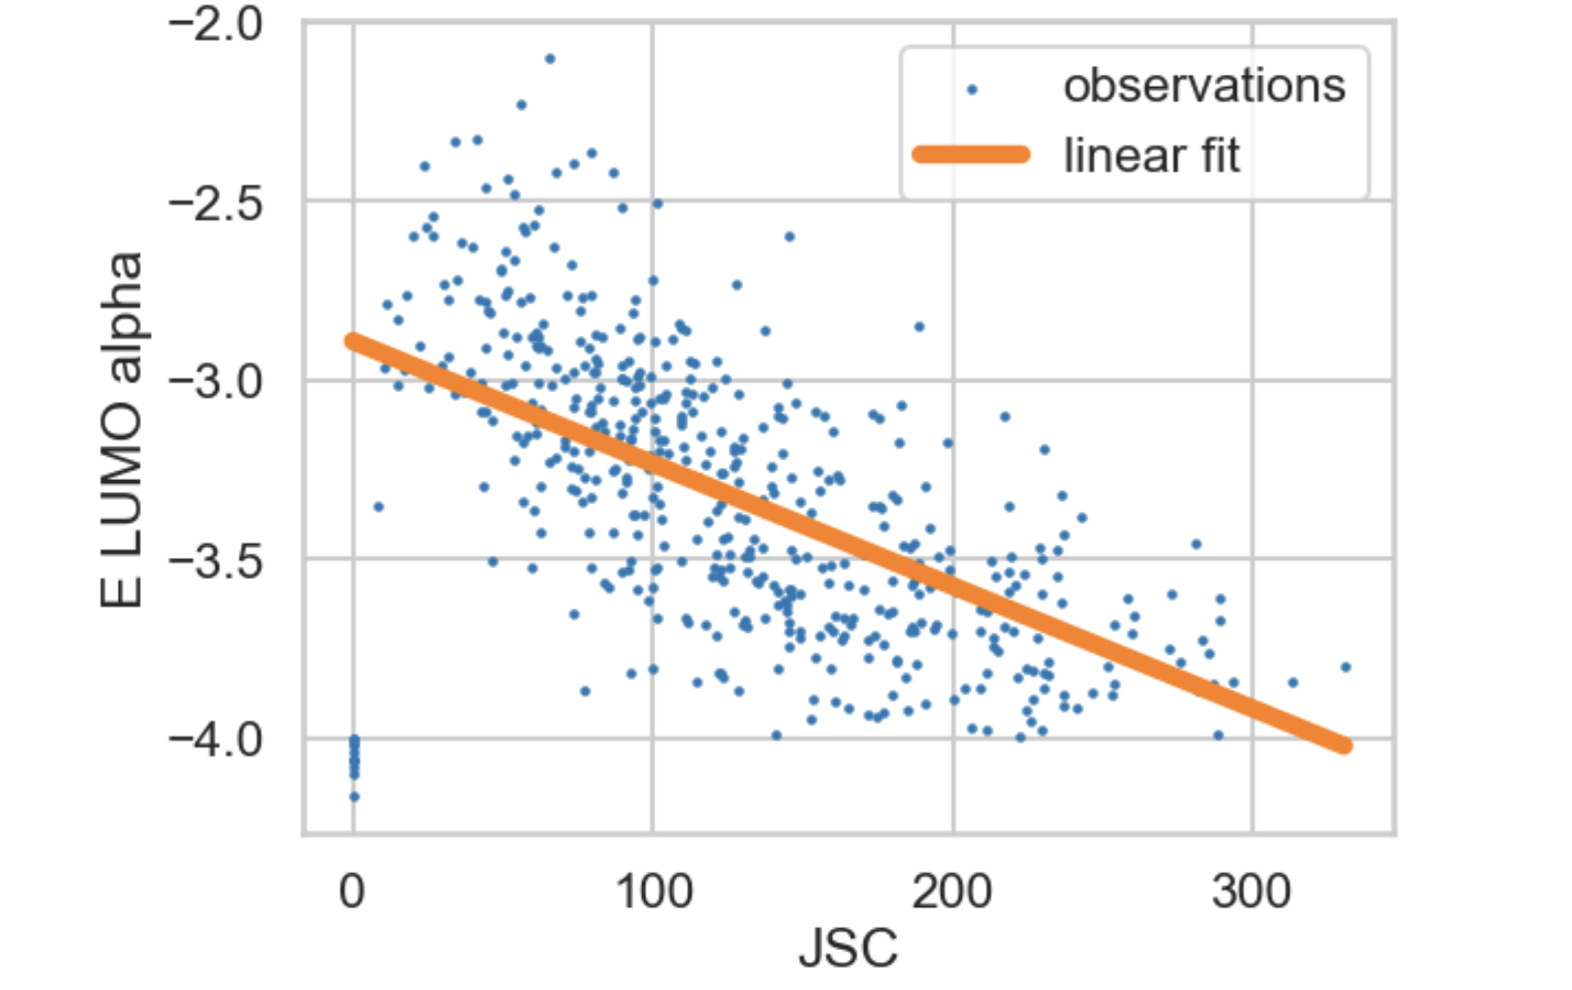
And so on…

Slide 19
Threshold?
Logistic probability
Class A
Class A
Class B
Class B

Slide 20
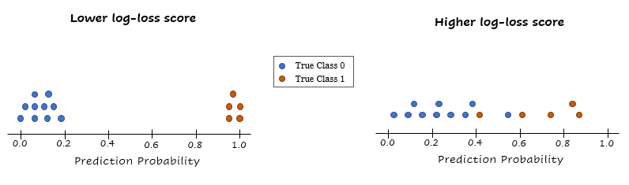

Slide 21
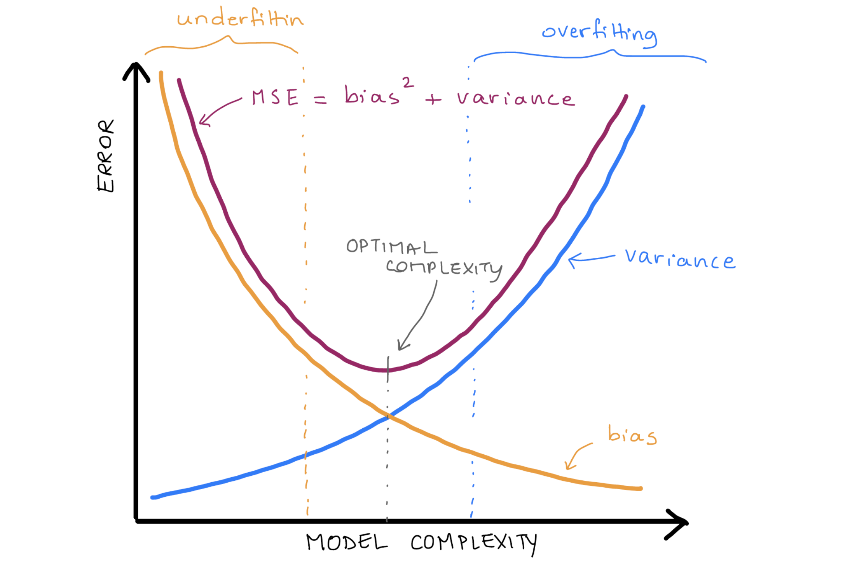

Slide 22
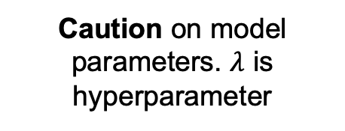
L2 Regularization
Error on data.
Caution on model parameters. $λ$ is hyperparameter

Slide 23
Training data
Testing data
Hyperparameters:
Architecture
Feature choices
Model Training
Model Evaluation
Performance
Update hyperparameters to improve model

Slide 24
Test set:
Use to evaluate and communicate performance
Development (dev) set:
Use for training and optimizing model
Training set:
Use for fitting model parameters
Validation set:
Use to estimate model performance while optimizing model

Slide 25
Training data
Testing data
Hyperparameters:
Architecture
Feature choices
Model Training
Model Evaluation
Performance
Model Validation
Update hyperparameters to improve model
Val data

Slide 26
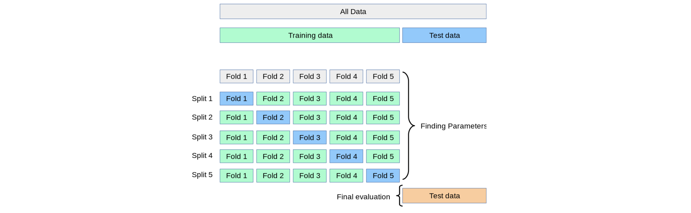
5-fold Cross Validation
Dev Data
Val Data

Slide 27
Leave-One-Out Cross Validation
Training
Validation
Dev datapoints
0, 1, 2, 3, 4, 5, 6, 7, 8, 9, 10, 11, 12, 13, 14, 15, 16, 17, …, N
Fold 0:
0, 1, 2, 3, 4, 5, 6, 7, 8, 9, 10, 11, 12, 13, 14, 15, 16, 17, …, N
Fold 1:
0, 1, 2, 3, 4, 5, 6, 7, 8, 9, 10, 11, 12, 13, 14, 15, 16, 17, …, N
…
Fold N:
0, 1, 2, 3, 4, 5, 6, 7, 8, 9, 10, 11, 12, 13, 14, 15, 16, 17, …, N

Slide 28
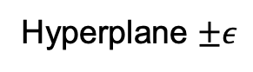
Hyperplane $±ε$
A
B

Slide 29
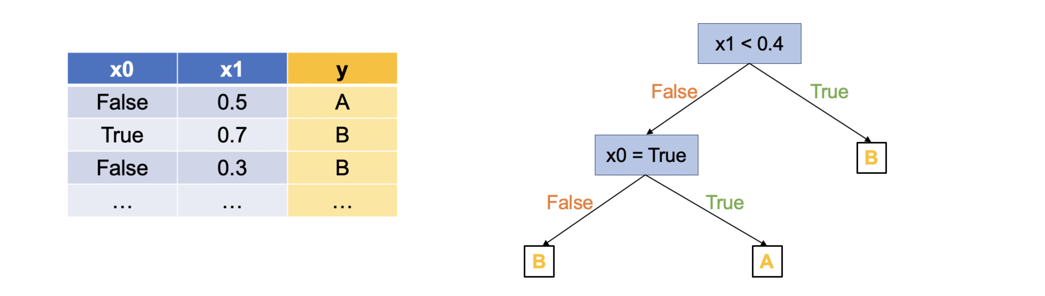
A
B

Slide 30
True Label
Class A
Class B
Feature
x0
Branch Threshold
Feature
x1

Slide 31

For training one tree in random forest
Repeat to make more trees
x0 | x1 | … | xn
y
Bag data and features randomly

Slide 32
A
B

Slide 33
A
B

Slide 34
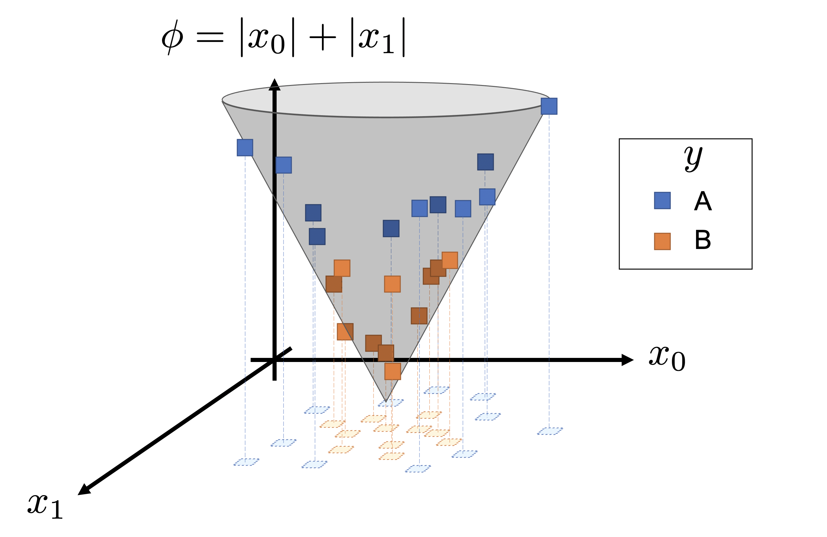

Slide 35
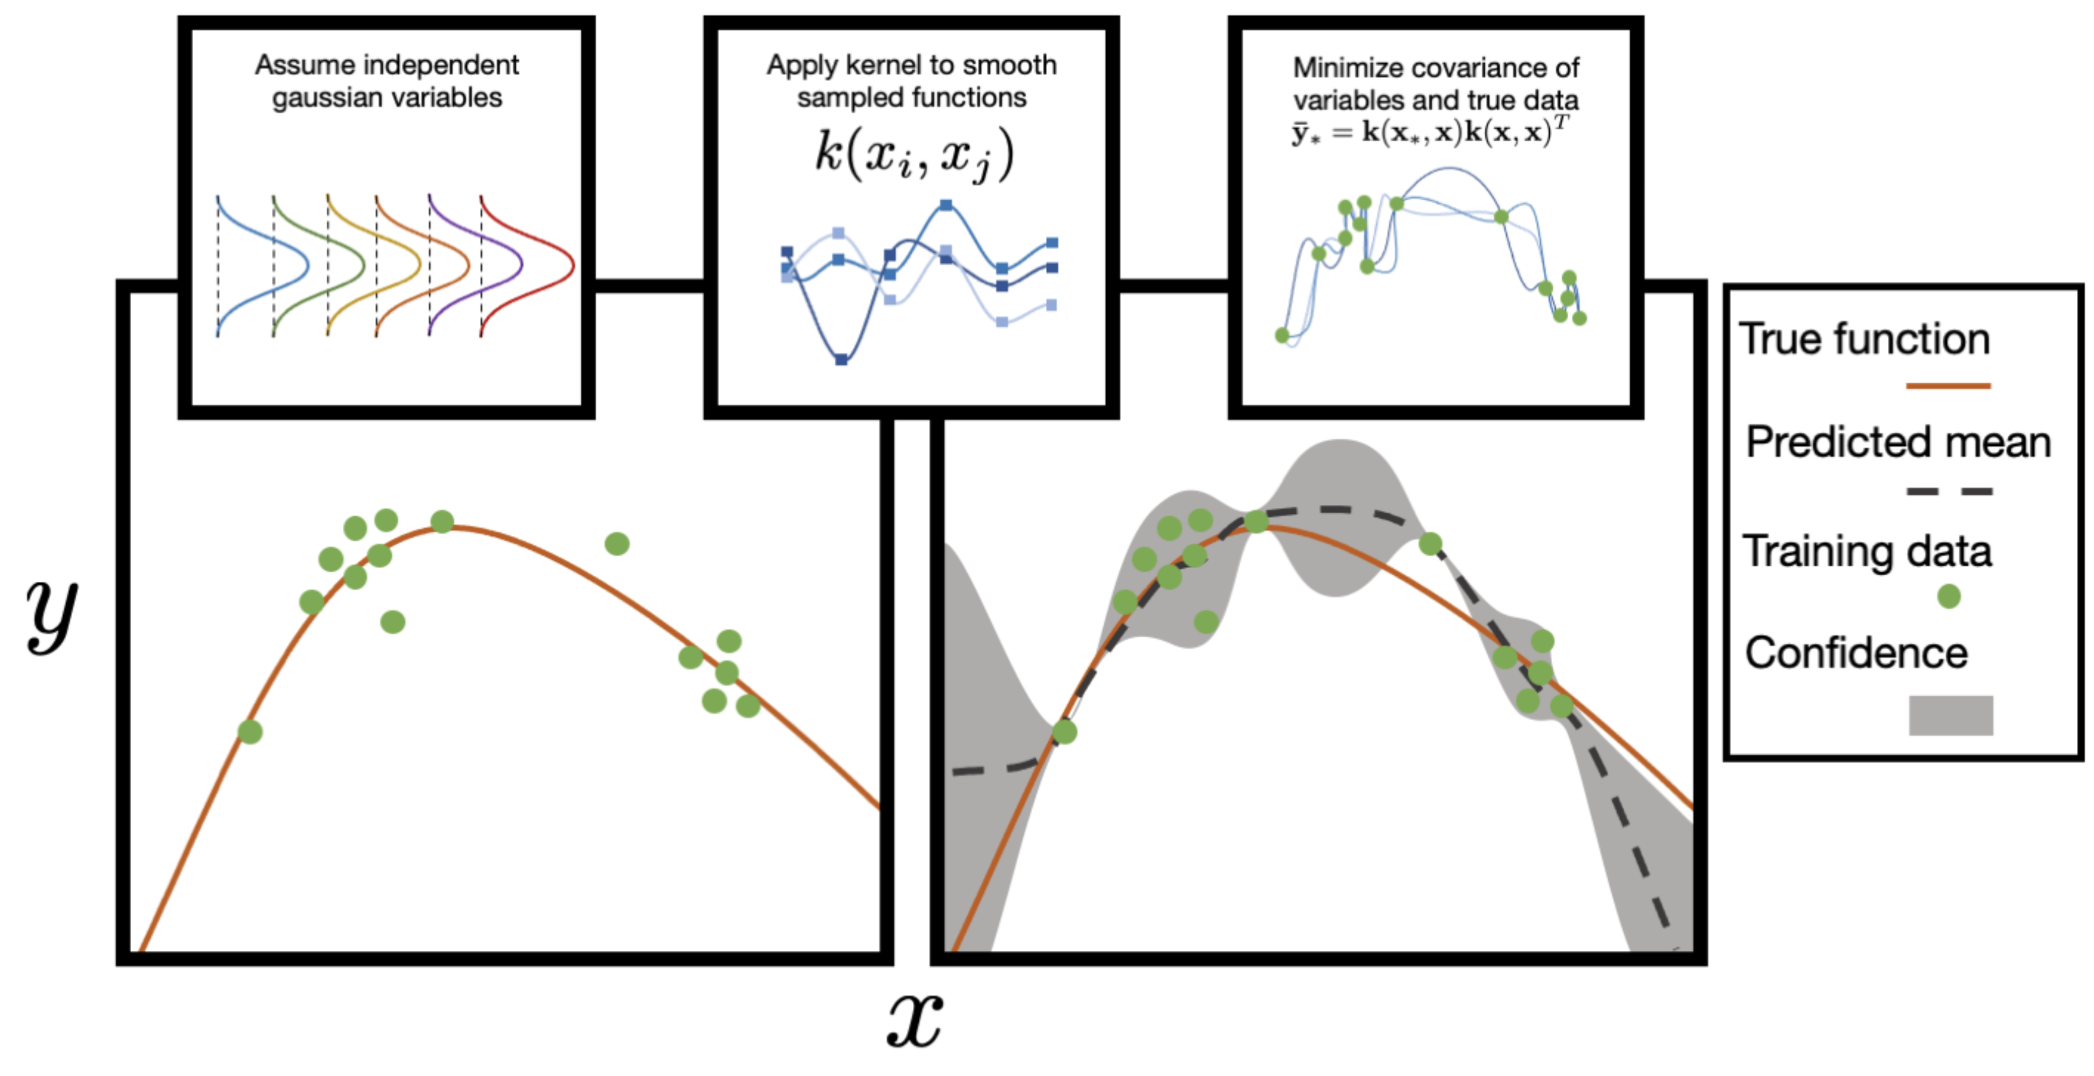

Slide 36
Gaussian Prior
Sample From Prior

Slide 37
Gaussian Prior
Sample From Linear Kernel
Sample From RBF Kernel

Slide 38
Data
Posterior (2 std)

Slide 39
Data
Posterior (2 std)
Sample from Post

Slide 40
Tree 1
Tree 2
…
Final Error
Data
Tree prediction

Slide 41
Unused Features
Current Features
Round 1
Take one
Train and Validate
Error
Error
Repeat all unused
Error
Take best
Unused Features
Current Features
Round 2
Train and Validate
Error
Error

Slide 43
Group B
Group A

Slide 44
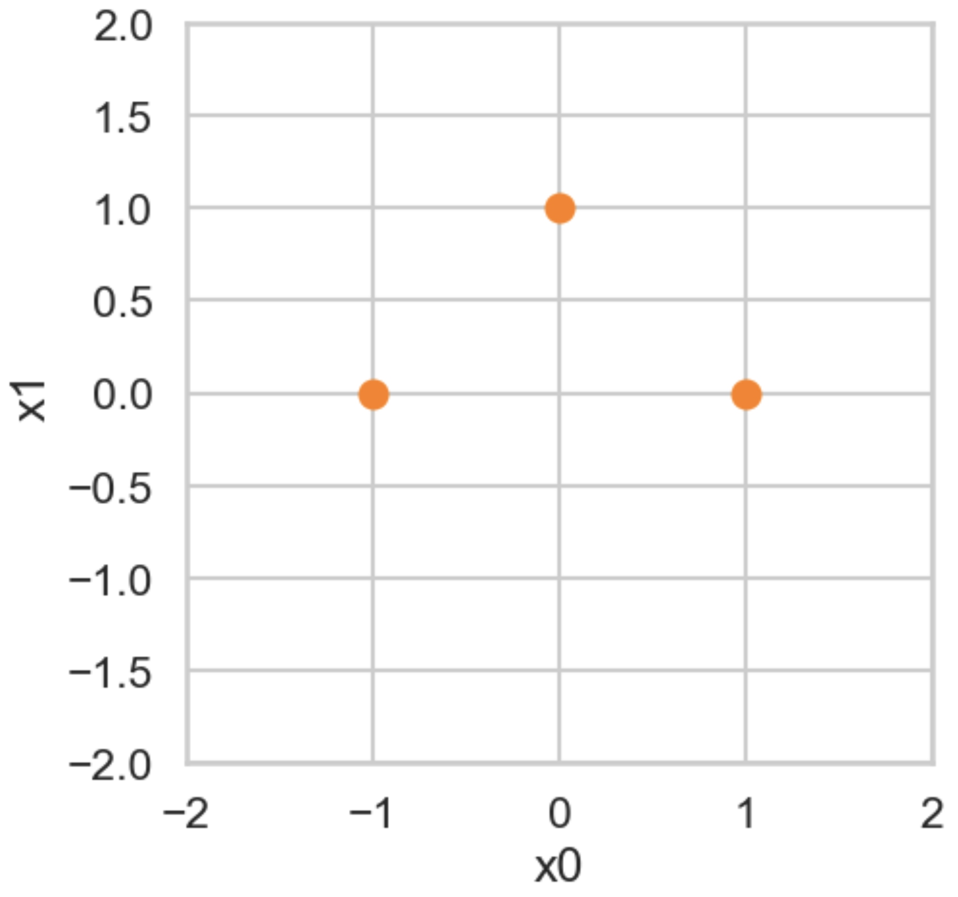

Slide 45
Observations
Predictive model
Proposed sample
A
B
C

Slide 46
Observations
True relationship
Proposed sample
A
B
C

Slide 47
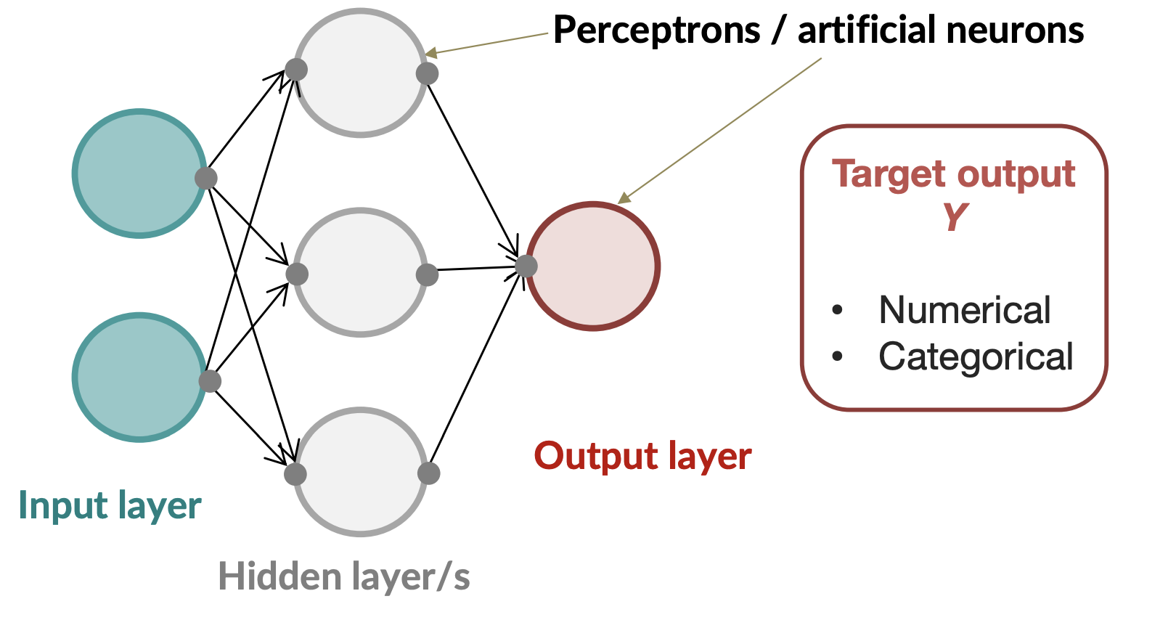
Features:
x0
x1
(make prediction)
(does nothing)
(Transform previous layer)

Slide 48
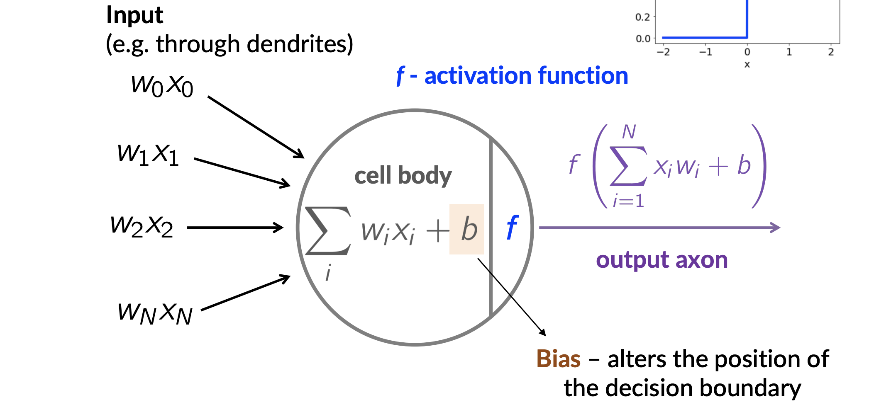
Neuron j in the first hidden layer:
Outputs of previous layer
value of activation

Slide 49
tanh
ReLU
1.0
0.0
-1.0
0.0
2.0
-2.0
0.0
2.0
-2.0

Slide 51
Transform inputs (X) to predicted outputs (y) using parameters (Forward pass)
Update parameters in the direction of smaller loss
Compare prediction to true values to compute loss
Compute derivative of all parameters with respect to loss

